Slide 1
Welcome To Our Java Project
SuperShop Management System

Slide 2
Contribute by
Din Mohammad Dohan ID: 17-34465-2
Sayed Mahmudul Hassan ID: 18-38095-2
Forhad Mahmud ID:18-37192-1
Md. Abul Basar Pias ID:18-38128-2

Slide 3
Introduction
Super Shop is a retail environment. A super shop is a large retailer who stocks and sells a wide variety of merchandise including groceries, clothing and general supplies, or a large store that sells a massive quantity of goods in one product line such as electronics or shoes and etc.
Super shops are very large supermarkets or shops selling household goods and equipment. Super shops are usually built outside city centers away from other shops. The best example of a superstore is Wal-Mart. A superstore is also referred to as a super center or mega-store.

Slide 4
What is Super Shop Management Software System?
Super shop is the active control program which allows the sales and purchases reelected activities.
Super shop management software helps create invoices, Product category, purchase orders, receiving lists, payment receipts and can print bar coded labels. A Super shop management software system configured to your warehouse, retail or product line will help to create revenue for your company. The Super shop Management will control operating costs and provide better understanding.

Slide 5
The benefits of Super shop Management System:
Nowadays, maintaining the Super shop is a tough challenge. If not properly managed, your Super shop’s result can in a significant expense.
A computerized Super shop management system can be a big asset to a company, whether large, medium or small. These systems can help the management in controlling the Super shop of the company to cut significant costs and have a dramatic impact on the financial bottom line of the company.

Slide 6
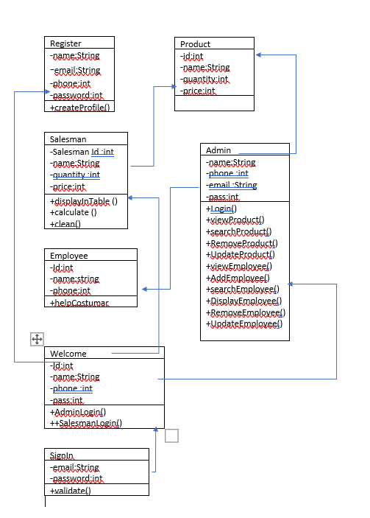

Slide 7
Case Study
Here have a system where admin can LogIn and he can add employee data ,update and remove employee data from database. Admin can also add product details ,update and remove product from database. Employee helps the customer what they needed. If a customer take their item in their cart and come to salesman for pay. sales man can calculate all product price with using this system and print out all product price for customer.

Slide 8
Advantage of our Software
We can easily maintain full shop.
We can save our employee and product details on database.
We also can update remove employee and product from database.
Here also have sales man option where we calculate sold product and also print sold product price for give customer.

Slide 9
Some lacking of our software
Every program have some lacking and bug , our management system also have some problem , such as here we are not use QR scanning system. we not give online virtual system ,we give only real life shop where customer come for shopping.

Slide 10
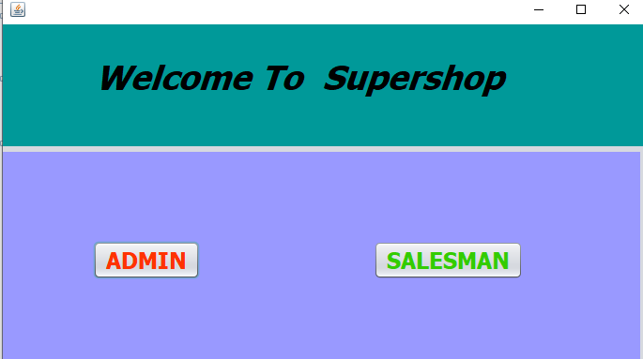
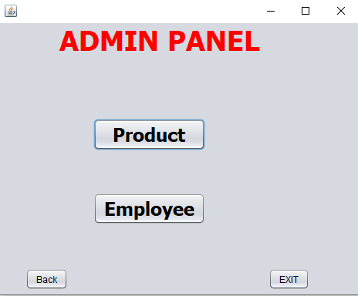

Slide 11
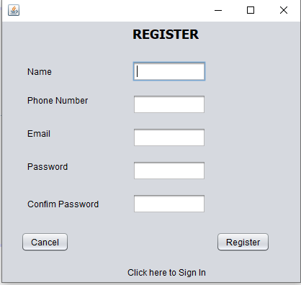
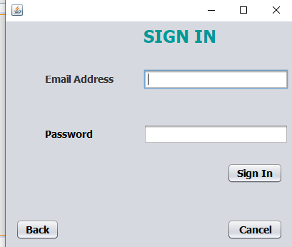
Registration & Sign In Option

Slide 12
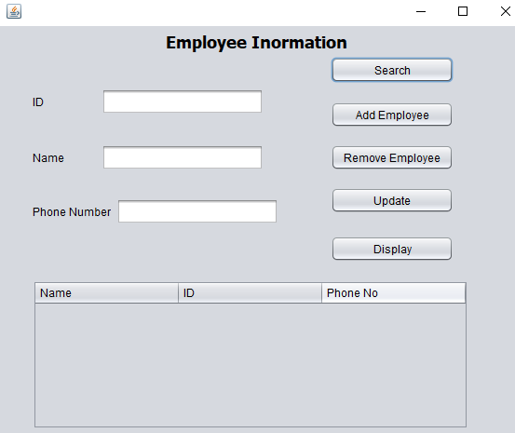
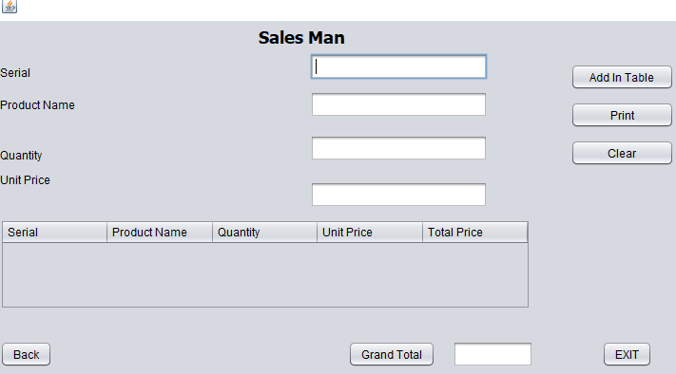
Employee Information & Sales Man

Slide 13
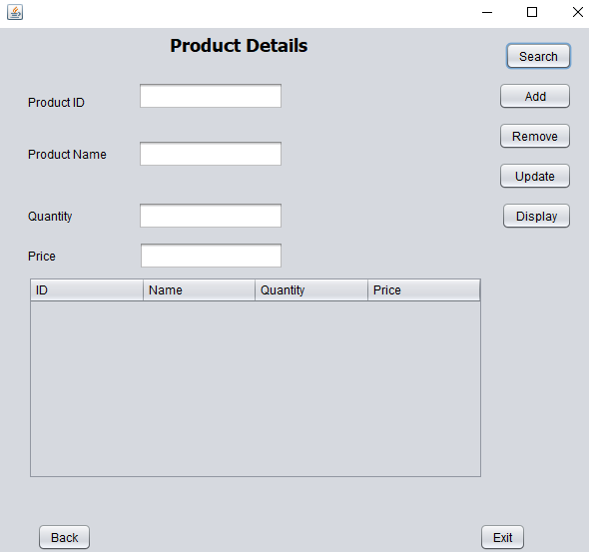
Product Details

Slide 14
Conclusion
The People are having a lot troubles while buying the everyday necessary product. They also have to waste their time. But now a day’s every time of a person is most valuable, nobody wants to waste time if he or she has the facility to get his or her desired service at a single moment.
We are confident that this Super shop management software system specification for the real-life Customer service refers to a departmental Super shop ability to satisfy of the management of supper shop needs.

Slide 15
Thank You All

